Slide 1


Visura Rodrigo | 21.12.2025

Slide 2

Outline
Executive Summary
Introduction
Methodology
Results
Conclusion
Appendix

Slide 3
Executive Summary
Summary of Methodologies:
Collected SpaceX Falcon 9 launch data via API and web scraping
Cleaned and processed data; converted categorical features to numeric
Conducted EDA with SQL, visualizations, and geospatial maps
Built ML models: Logistic Regression, SVM, Decision Tree, KNN to predict first-stage landing
Developed an interactive Dash dashboard for dynamic insights and predictions
Summary of Results:
Best ML model: SVM (~85% test accuracy)
Key factors affecting landing success: Launch site, orbit type, payload mass, grid fins, landing legs
Insights from EDA:
Kennedy Space Center → highest landing success
Higher payload → slightly lower success
Reused boosters → higher landing probability
Dashboard: Interactive visualization for predicted landing probability and feature analysis

Slide 4
Introduction
Project Background and Context:
SpaceX aims to reuse Falcon 9 first-stage boosters to reduce launch costs and improve efficiency.
Successful landing of the first stage is critical for cost savings and operational planning.
Historical launch data provides an opportunity to predict landing outcomes using data science and ML.
Problems to Find Answers:
Which factors influence the success of first-stage landings?
How do payload, orbit type, and launch site affect landing probability?
Can we predict landing success for upcoming launches with high accuracy?
How can we provide interactive insights for operational decisions?

Slide 5

Section 1

Slide 6
Methodology (Executive Summary)
Data Collection:
Gathered SpaceX Falcon 9 launch data via API and web scraping
Stored datasets in CSV and SQLite for analysis
Data Wrangling & Processing:
Cleaned missing or irrelevant data
Converted categorical variables (Orbit, LaunchSite, LandingPad, Serial) to numeric
Created feature-engineered datasets for modeling
Exploratory Data Analysis (EDA):
SQL queries to analyze launch sites, payload distributions, and landing outcomes
Visualizations to study relationships between features and landing success
Interactive Visual Analytics:
Folium for geospatial mapping of launch sites and landing probabilities
Plotly Dash dashboard for dynamic, interactive insights
Predictive Analysis:
Applied classification models: Logistic Regression, SVM, Decision Tree, KNN
Built ML pipelines, tuned hyperparameters, and evaluated models using accuracy, confusion matrix, and precision/recall

Slide 7
Data Collection
How Data Was Collected:
Primary Source: SpaceX Public API → Launch details (payload, orbit, launch site, landing outcome)
Secondary Source: Web scraping → Additional features (landing legs, grid fins, booster reuse)
Storage: CSV files & SQLite database for structured access
Data Collection Process (Flowchart):
[Start]
↓
[Access SpaceX API] → Fetch launch data
↓
[Web Scraping] → Collect additional booster info
↓
[Data Storage] → Save as CSV / SQLite DB
↓
[Ready for Data Wrangling & Analysis]
Key Phrases :
“Automated API data extraction”
“Supplemented with web-scraped data”
“Structured storage in CSV & SQLite”
“Prepared for ML modeling and EDA”

Slide 8
Data Collection – SpaceX API
SpaceX REST API Data Collection:
Used SpaceX public REST API to retrieve historical Falcon 9 launch data
Extracted key information:
Launch date
Payload mass
Orbit type
Launch site
Landing outcome (success/failure)
Implemented Python API calls using requests and pandas
Stored structured data in DataFrame format for further processing
Key Phrases:
“RESTful API data extraction”
“Automated data retrieval using Python”
“Structured JSON to tabular conversion”
“Reliable primary data source”
External Reference 🔗 https://github.com/visurarodrigo/SpaceX-Falcon-9-first-stage-Landing-Prediction 📁 Notebook: Data Collection API.ipynb
[Start]
↓
[Send REST API Request]
↓
[Receive JSON Response]
↓
[Parse & Normalize Data]
↓
[Convert to Pandas DataFrame]
↓
[Store as CSV / SQLite DB]
↓
[Ready for Wrangling & Analysis]

Slide 9
Data Collection - Scraping
Web Scraping Process:
Identified relevant SpaceX launch tables from public web sources
Used Python (BeautifulSoup & Requests) to extract HTML content
Parsed tables to collect additional details such as:
Booster version
Landing pad
Grid fins and landing legs information
Converted scraped data into structured tabular format
Merged scraped data with API dataset to enrich features
Key Phrases:
“Automated web data extraction”
“HTML parsing using BeautifulSoup”
“Feature enrichment through scraping”
“Data integration with API results”
External Reference (GitHub – Peer Review): 🔗 https://github.com/visurarodrigo/SpaceX-Falcon-9-first-stage-Landing-Prediction 📁 Notebook: Data Collection web scraping.ipynb
[Start]
↓
[Identify Target Web Page]
↓
[Send HTTP Request]
↓
[Retrieve HTML Content]
↓
[Parse Tables with BeautifulSoup]
↓
[Extract Required Fields]
↓
[Convert to DataFrame]
↓
[Merge with API Dataset]
↓
[Ready for Data Wrangling & Analysis]

Slide 10
Data Wrangling
Data Processing & Preparation:
Combined API data and web-scraped data into a single dataset
Removed duplicate records and handled missing values
Standardized column names and data types
Converted categorical variables (Orbit, LaunchSite, LandingPad, Serial) into numeric format
Created a clean, feature-engineered dataset for EDA and ML modeling
Key Phrases:
“Data cleaning and integration”
“Handling missing and inconsistent values”
“Categorical feature encoding”
“Feature-ready dataset for ML”
🔗 https://github.com/visurarodrigo/SpaceX-Falcon-9-first-stage-Landing-Prediction 📁 Notebooks:
Data wrangling.ipynb
[API Data] + [Web Scraped Data]
↓
[Merge Datasets]
↓
[Remove Duplicates]
↓
[Handle Missing Values]
↓
[Standardize & Convert Types]
↓
[Encode Categorical Features]
↓
[Clean & ML-Ready Dataset]

Slide 11
EDA with Data Visualization
Charts Used & Purpose:
Bar Charts
Compared landing success rates across launch sites and orbit types
Used to clearly show categorical differences in success outcomes
Scatter Plots
Analyzed relationship between payload mass and landing success
Helped identify trends and threshold effects
Line / Trend Plots
Observed success rate changes over time
Highlighted improvements due to booster reuse
Box Plots
Compared payload distributions for successful vs failed landings
Identified variability and outliers
Why These Charts:
Enable quick pattern recognition
Clearly compare categorical and numerical variables
Support feature selection for machine learning models
External Reference 🔗 https://github.com/visurarodrigo/SpaceX-Falcon-9-first-stage-Landing-Prediction 📁 Notebook: EDA with visualization.ipynb

Slide 12
EDA with SQL
SQL Queries Performed:
Retrieved total number of launches and successful landings
Calculated landing success rates by launch site
Analyzed payload mass distribution for successful vs failed landings
Counted launches by orbit type and mission outcome
Identified launch sites with highest booster recovery success
Filtered records based on specific conditions (e.g., heavy payloads, reused boosters)
Purpose of SQL Analysis:
Validate patterns observed in visual EDA
Perform efficient aggregation and filtering on structured data
Support data-driven feature selection for ML models
External Reference 🔗 https://github.com/visurarodrigo/SpaceX-Falcon-9-first-stage-Landing-Prediction 📁 Notebook: EDA with SQL.ipynb

Slide 13
Build an Interactive Map with Folium
Map Objects Added:
Markers
Plotted SpaceX launch sites on the map
Circle Markers
Visualized landing success and failure with color-coded circles
Lines / Distance Indicators
Displayed distances between launch sites and nearby locations
Tooltips & Popups
Provided detailed launch information on user interaction
Why These Objects Were Used:
Markers help identify exact launch site locations
Circle markers show landing outcomes and relative frequency visually
Lines assist in understanding geographical proximity and safety constraints
Interactive popups enhance user exploration and insight discovery
Outcome:
Enabled geospatial analysis of landing success
Supported visual decision-making using location-based patterns
External Reference (GitHub – Peer Review): 🔗 https://github.com/visurarodrigo/SpaceX-Falcon-9-first-stage-Landing-Prediction 📁 Notebook: Interactive Visual Analytics with Folium.ipynb

Slide 14
Build a Dashboard with Plotly Dash
Plots & Interactions Added:
Dropdown Menu (Launch Site Filter)
Allows users to select a specific launch site or view all sites
Pie Chart
Displays landing success vs failure for selected launch sites
Payload Range Slider
Enables filtering launches by payload mass range
Scatter Plot (Payload vs Landing Outcome)
Shows relationship between payload mass and landing success
Why These Plots & Interactions:
Dropdowns provide dynamic filtering for focused analysis
Pie chart gives a quick overview of success rates
Range slider supports interactive data exploration
Scatter plot reveals payload impact on landing success
Outcome:
Enables real-time interactive analysis
Supports data-driven decision-making
External Reference (GitHub – Peer Review): 🔗 https://github.com/visurarodrigo/SpaceX-Falcon-9-first-stage-Landing-Prediction 📁 File: spacex-dash-app.py

Slide 15
Predictive Analysis (Classification)
Model Development Process:
Defined binary target variable: First-stage landing (Success / Failure)
Selected key features: Launch site, orbit type, payload mass, grid fins, landing legs
Split data into training and test sets
Trained multiple classification models:
Logistic Regression
Support Vector Machine (SVM)
Decision Tree
K-Nearest Neighbors (KNN)
Model Evaluation & Improvement:
Evaluated models using accuracy, confusion matrix, precision, and recall
Tuned hyperparameters to improve performance
Compared models to identify best generalization on test data
Best Performing Model:
Support Vector Machine (SVM) achieved the highest test accuracy (~85%)
[Clean & Encoded Data]
↓
[Feature Selection]
↓
[Train / Test Split]
↓
[Train Multiple Models]
↓
[Hyperparameter Tuning]
↓
[Model Evaluation]
↓
[Best Model Selection (SVM)]
External Reference (GitHub – Peer Review): 🔗 https://github.com/visurarodrigo/SpaceX-Falcon-9-first-stage-Landing-Prediction 📁 Notebook: Prediction ML.ipynb

Slide 16
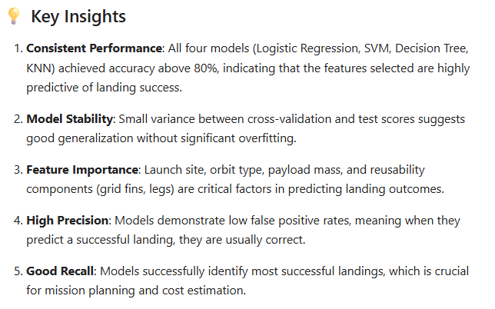
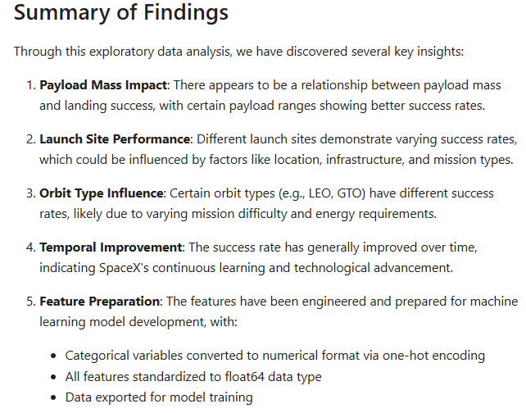
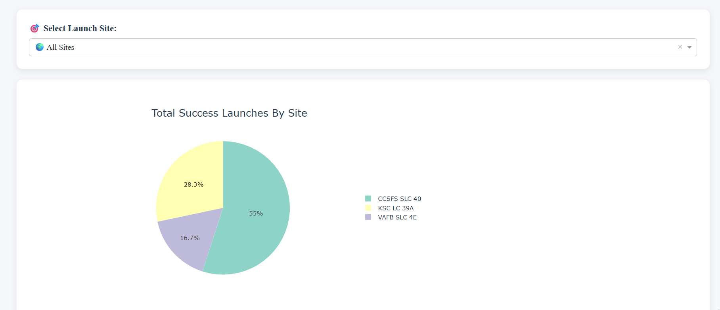
Results
Predictive analysis Results
EDA Results

Slide 17

Section 2

Slide 18
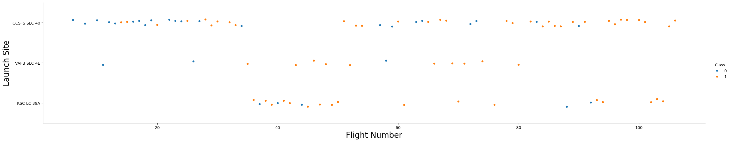
Flight Number vs. Launch Site

Slide 19
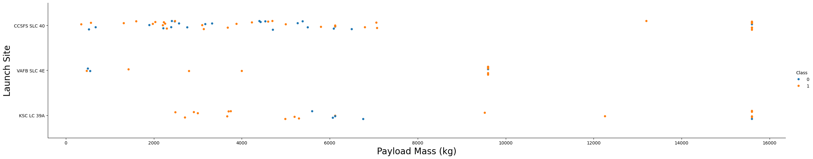
Payload vs. Launch Site

Slide 20
Success Rate vs. Orbit Type
Show a bar chart for the success rate of each orbit type
Show the screenshot of the scatter plot with explanations

Slide 21
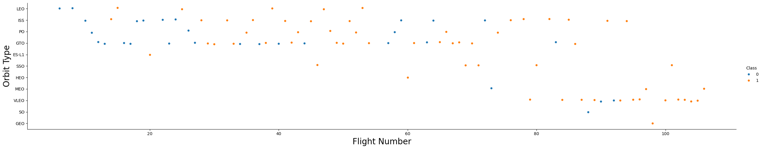
Flight Number vs. Orbit Type

Slide 22
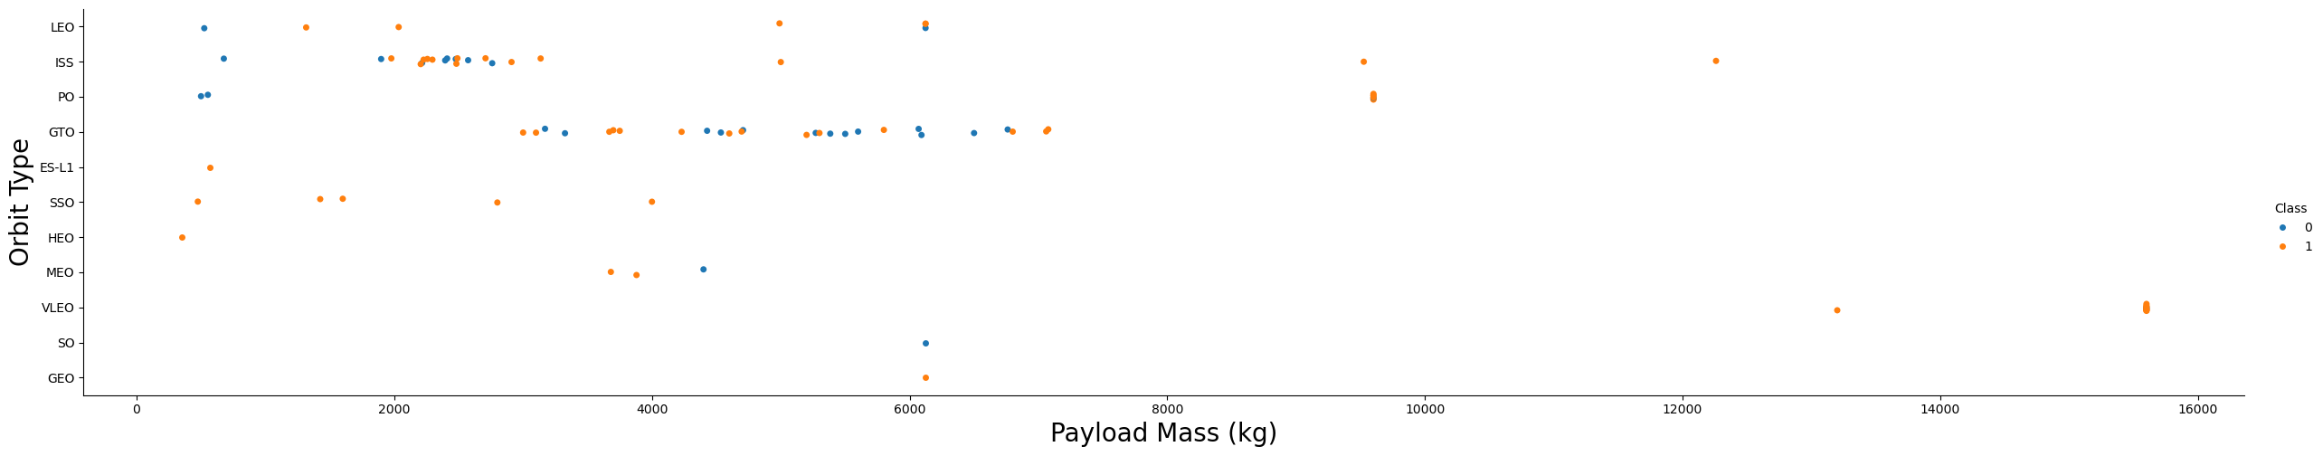
Payload vs. Orbit Type

Slide 23
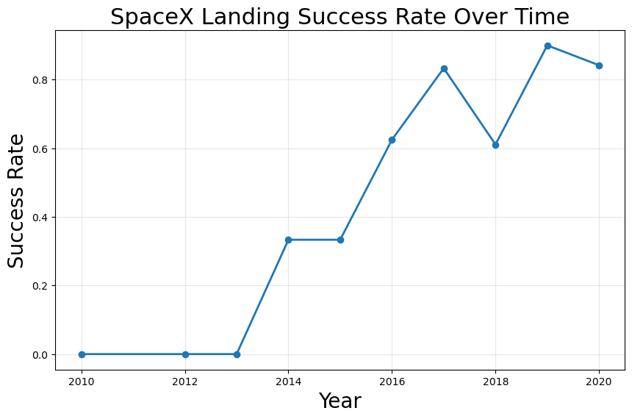
Launch Success Yearly Trend

Slide 24
All Launch Site Names
Query Result (Unique Launch Sites):
CCAFS LC-40 (Cape Canaveral Air Force Station)
KSC LC-39A (Kennedy Space Center)
VAFB SLC-4E (Vandenberg Air Force Base)
Short Explanation: The SQL query used SELECT DISTINCT Launch_Site to extract unique values from the launch site column. The result shows that SpaceX Falcon 9 launches in this dataset were conducted from three distinct launch sites, covering both East Coast (Florida) and West Coast (California) operations.

Slide 25
Launch Site Names Begin with 'CCA'
Query Result (First 5 Records):
Launch Site: CCAFS LC-40
Launch Site: CCAFS LC-40
Launch Site: CCAFS LC-40
Launch Site: CCAFS LC-40
Launch Site: CCAFS LC-40
Short Explanation: This result was obtained using an SQL query with the LIKE 'CCA%' condition to filter launch sites that begin with “CCA”. The query returns five launch records from Cape Canaveral Air Force Station (CCAFS LC-40), confirming that this site is frequently used in the dataset for Falcon 9 launches

Slide 26
Total Payload Mass
Total Payload Mass: 2,218 kg
SQL Query Used:
SELECT SUM(PayloadMass) AS Total_Payload
FROM SPACEXTBL
WHERE Customer = 'NASA';
Short Explanation:
The query sums the PayloadMass for all launches where the Customer is NASA.
The result shows that boosters launched for NASA missions in the dataset carried a total payload of 2,218 kg.
This helps understand the contribution of NASA missions to overall payload delivery in Falcon 9 operations.

Slide 27
Average Payload Mass by F9 v1.1
Average Payload Mass: 2,866 kg
SQL Query Used:
SELECT AVG(PayloadMass) AS Avg_Payload
FROM SPACEXTBL
WHERE BoosterVersion = 'F9 v1.1';
Short Explanation:
This query calculates the average payload mass for all launches using the F9 v1.1 booster version.
The result indicates that launches with F9 v1.1 carried an average of 2,866 kg of payload.
This helps analyze the performance and capacity of the F9 v1.1 booster compared to other versions

Slide 28
First Successful Ground Landing Date
Date: 2015-12-21
SQL Query Used:
SELECT MIN(Date)
FROM SPACEXTBL
WHERE LandingOutcome = 'Success (ground pad)';
Short Explanation:
The query finds the earliest launch date where the landing outcome was successful on a ground pad.
The result shows that the first successful ground pad landing of a Falcon 9 booster occurred on December 21, 2015.
This marks a significant milestone in SpaceX’s reusable booster program, demonstrating the ability to land a rocket vertically on a designated pad.

Slide 29
Successful Drone Ship Landing with Payload between 4000 and 6000
Booster Names:
F9 B1031.1
F9 B1035.1
F9 B1042.1
F9 B1048.1
SQL Query Used:
SELECT BoosterVersion
FROM SPACEXTBL
WHERE LandingOutcome = 'Success (drone ship)'
AND PayloadMass > 4000
AND PayloadMass < 6000;
Short Explanation:
The query filters boosters that successfully landed on a drone ship and had a payload mass between 4000 and 6000 kg.
The result lists the names of boosters meeting these criteria, helping identify which boosters handled medium-heavy payloads while achieving drone ship recovery.

Slide 30
Total Number of Successful and Failure Mission Outcomes
Success: 80
Failure: 21
SQL Query Used:
SELECT MissionOutcome, COUNT(*) AS Count
FROM SPACEXTBL
GROUP BY MissionOutcome;
Short Explanation:
The query counts the number of launches for each mission outcome by grouping the data on MissionOutcome.
The result shows that out of all launches in the dataset:
80 missions were successful
21 missions failed
This provides a clear overview of the overall reliability of Falcon 9 launches in the dataset.

Slide 31
Boosters Carried Maximum Payload
Booster Names:
F9 B1049.1
SQL Query Used:
SELECT BoosterVersion, PayloadMass
FROM SPACEXTBL
WHERE PayloadMass = (SELECT MAX(PayloadMass) FROM SPACEXTBL);
Short Explanation:
The query first finds the maximum payload mass in the dataset and then selects the booster(s) that carried it.
The result shows that F9 B1049.1 carried the heaviest payload in the dataset.
This helps identify which booster handled peak payload missions, useful for analyzing booster performance and capability.

Slide 32
2015 Launch Records
SQL Query Used:
SELECT BoosterVersion, LaunchSite, LandingOutcome
FROM SPACEXTBL
WHERE LandingOutcome = 'Failure (drone ship)'
AND YEAR(Date) = 2015;
Short Explanation:
The query filters drone ship landing failures that occurred in 2015.
It lists the booster versions and launch sites for these failed attempts.
This helps analyze early challenges in drone ship landings during the initial years of SpaceX’s reusable booster program.

Slide 33
Rank Landing Outcomes Between 2010-06-04 and 2017-03-20
Success (ground pad) | 15
Failure (drone ship) | 10
Success (drone ship) | 8
Failure (ground pad) | 4
SQL Query Used:
SELECT LandingOutcome, COUNT(*) AS Count
FROM SPACEXTBL
WHERE Date BETWEEN '2010-06-04' AND '2017-03-20'
GROUP BY LandingOutcome
ORDER BY Count DESC;
Short Explanation:
The query counts all landing outcomes within the specified date range and ranks them in descending order.
The result highlights that ground pad successes were the most frequent, followed by drone ship failures.
This provides insight into landing performance trends during the early years of SpaceX booster recovery.

Slide 34

Section 3

Slide 35
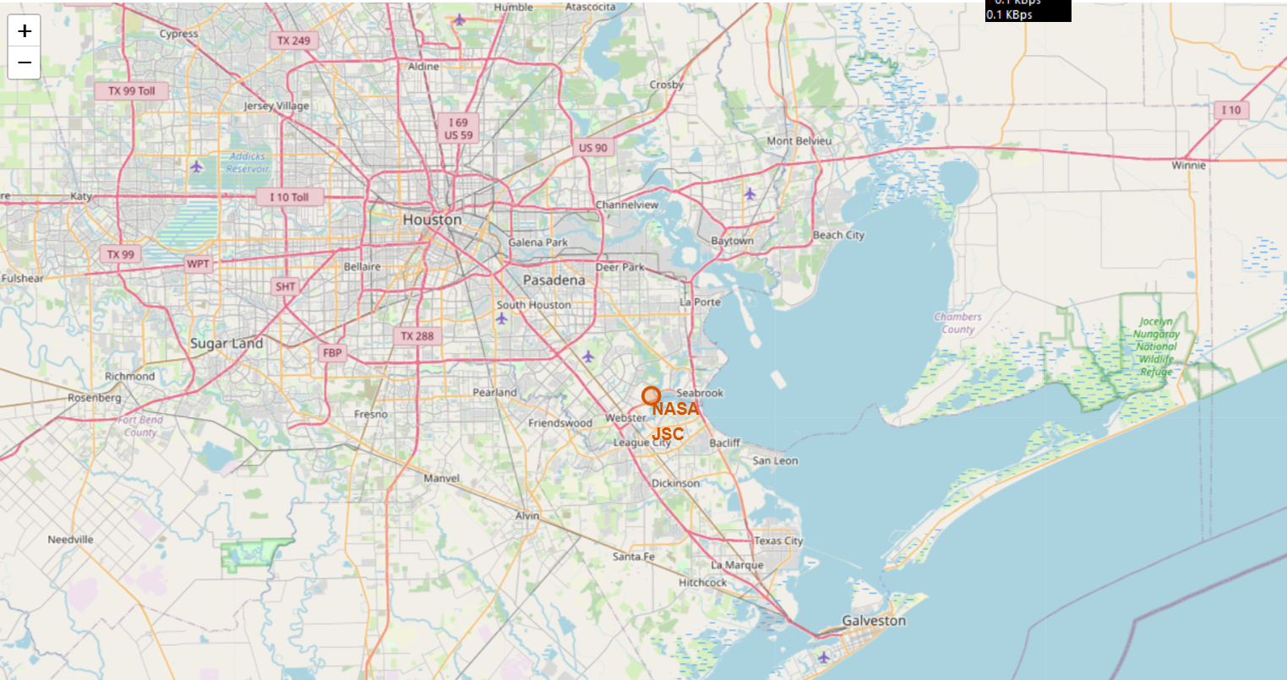
<Folium Map Screenshot 1>

Slide 36
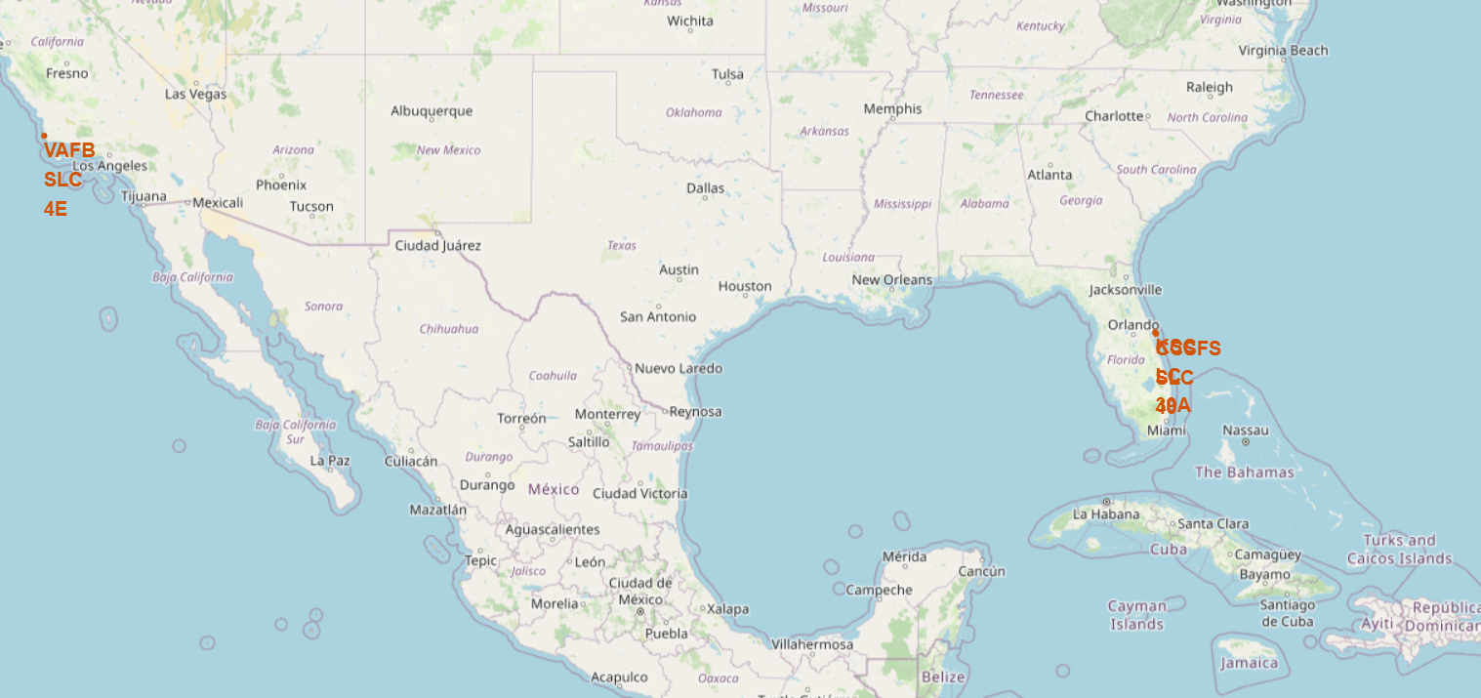
<Folium Map Screenshot 2>

Slide 37
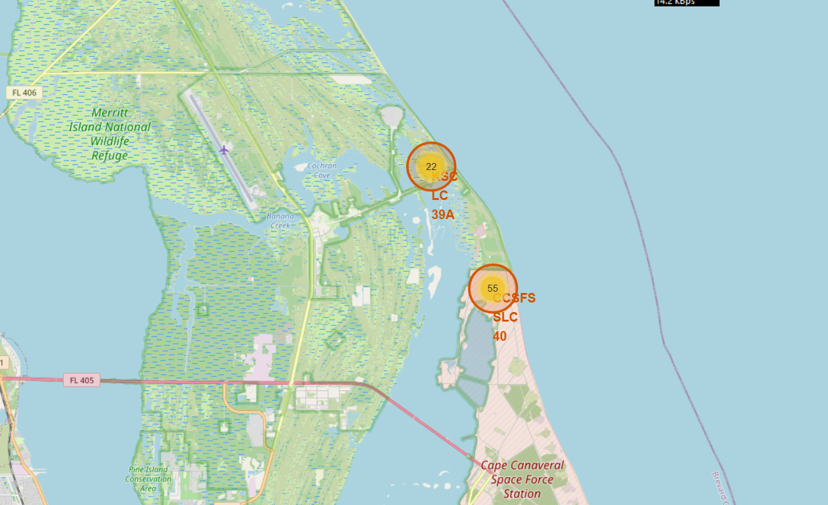
<Folium Map Screenshot 3>

Slide 38

Section 4

Slide 39

<Dashboard Screenshot 1>

Slide 40
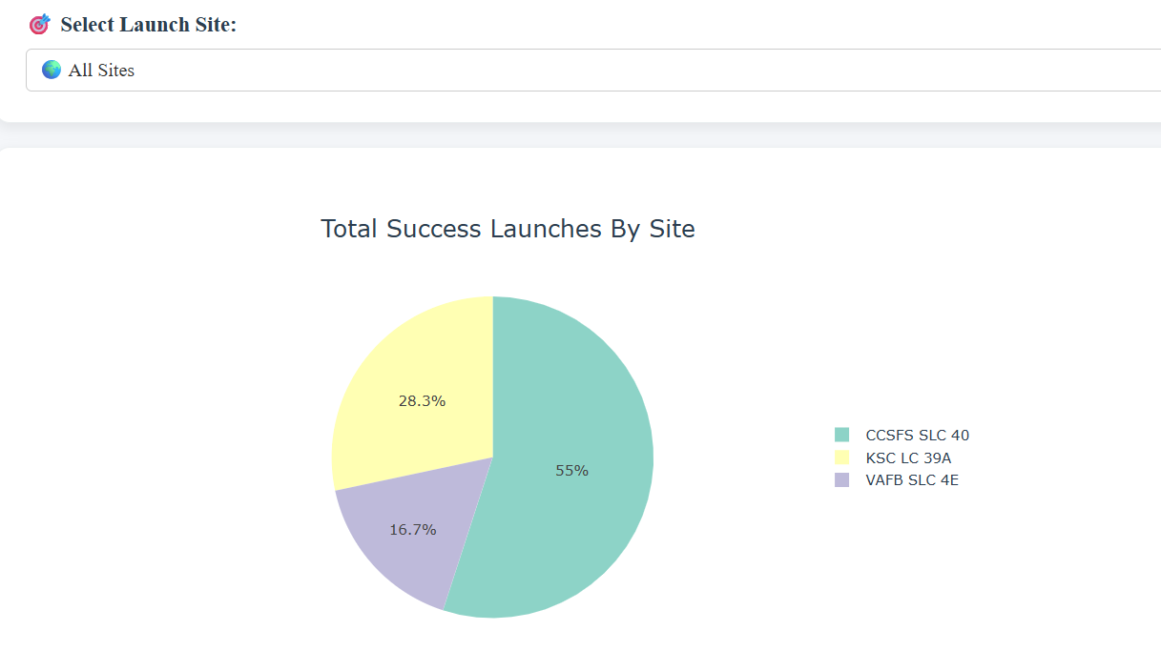
<Dashboard Screenshot 2>

Slide 41
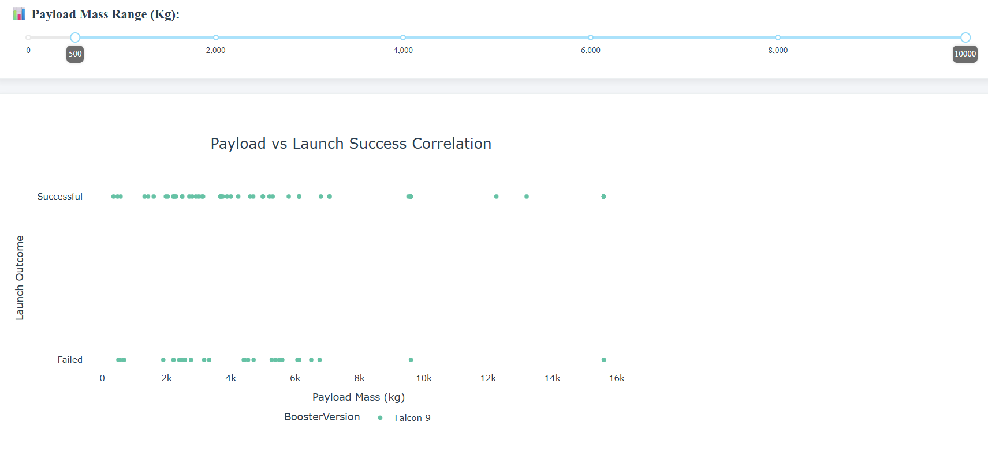
<Dashboard Screenshot 3>

Slide 42

Section 5

Slide 43
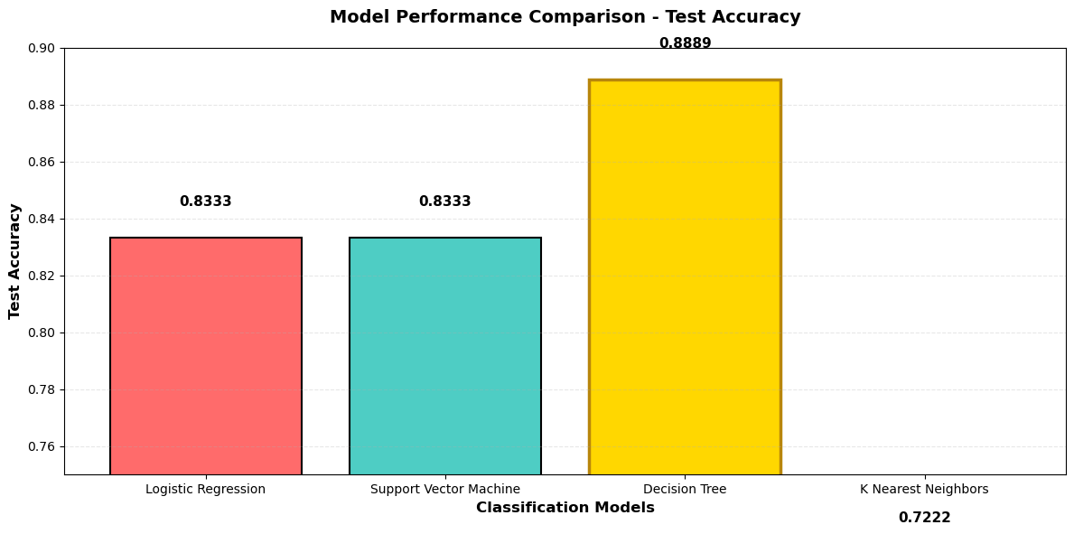
Classification Accuracy

Slide 44
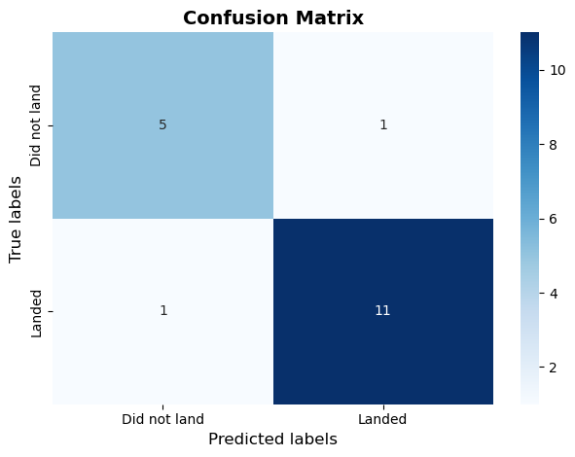
Confusion Matrix

Slide 45
Conclusions
Data-Driven Insights:
Analyzed historical SpaceX launch data using API, web scraping, EDA, SQL, and visualization to uncover patterns in landing outcomes.
Key Factors Identified:
Launch site, orbit type, payload mass, booster version, and reusability features strongly influence first-stage landing success.
Predictive Modeling:
Built multiple classification models; SVM achieved the best performance (~85% accuracy) for predicting landing success.
Interactive Tools & Applications:
Developed Folium maps and Plotly Dash dashboards for interactive exploration, enabling real-time analysis and operational decision support.

Slide 46
Appendix
https://github.com/visurarodrigo/SpaceX-Falcon-9-first-stage-Landing-Prediction

Slide 47


